Slide 1
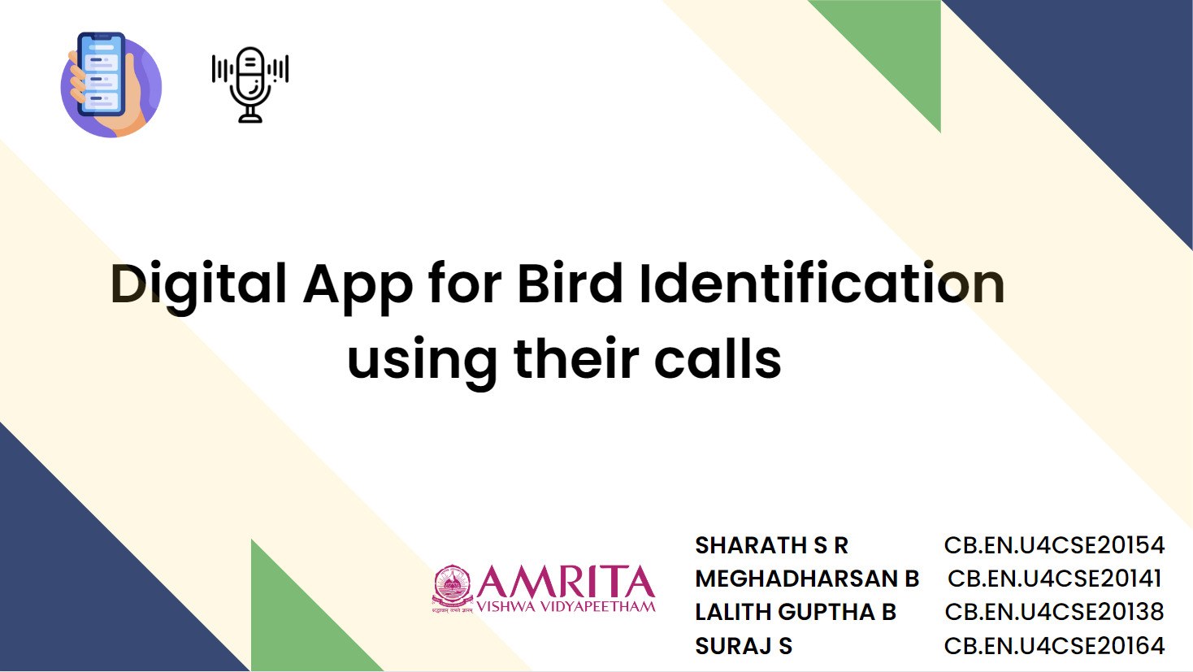

Slide 2




Idea/concept
Building a voice recognition model that identifies the birds along with their type of calls ( such as frightening sound, mating call etc.) and identifying their gender.
The model focuses on common birds visiting the campus, identifying them, analysing its population trends and predicting the occurrence of endangered ones in the targeted area - using Convolutional Neural Networks, based on a labelled dataset consisting of different features.
The model should filter the unnecessary noise in the recording(human intervention, wind sounds), find patterns in the songs which belong to the same species.

Slide 3
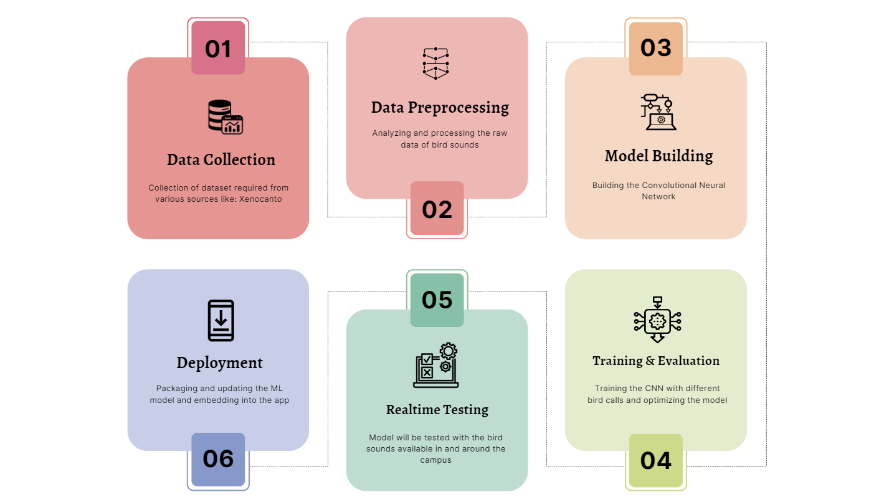
Basic architecture/flow chart

Slide 4





Technology stack
Challenges
Pitch Detection Algorithm - To verify frequency matches with available classes
PyTorch, TensorFlow - Building the Model
Kotlin - Android App Development
TensorFlow Lite - Deploying the ML model
Various disturbances in the recording - wind , human interventions and other noises.
Existence of multiple bird sounds in the same audio
Imbalance in the dataset due to the prevalence of more data for a particular species alone
Patterns Recognition in the songs for the birds in the same species
Identifying rare birds is hard due to the less availability or lack of its sounds

Slide 5


The functioning of the app is dependent on connectivity to the host machine (Resource dependency)
The audio recorded in the user phone must be of readable format(External dependency)
Real time data accuracy depends on whether the dataset is balanced or not
Our app analyzes the population trends of the birds
Identification and statistical analysis on endangered species and reducing its risk of getting extinct
Identifies threats for bird / environment in a certain area based on number of frightening calls

